Slide 1
Bare International Analysis
Project Summary Presentation

Slide 2
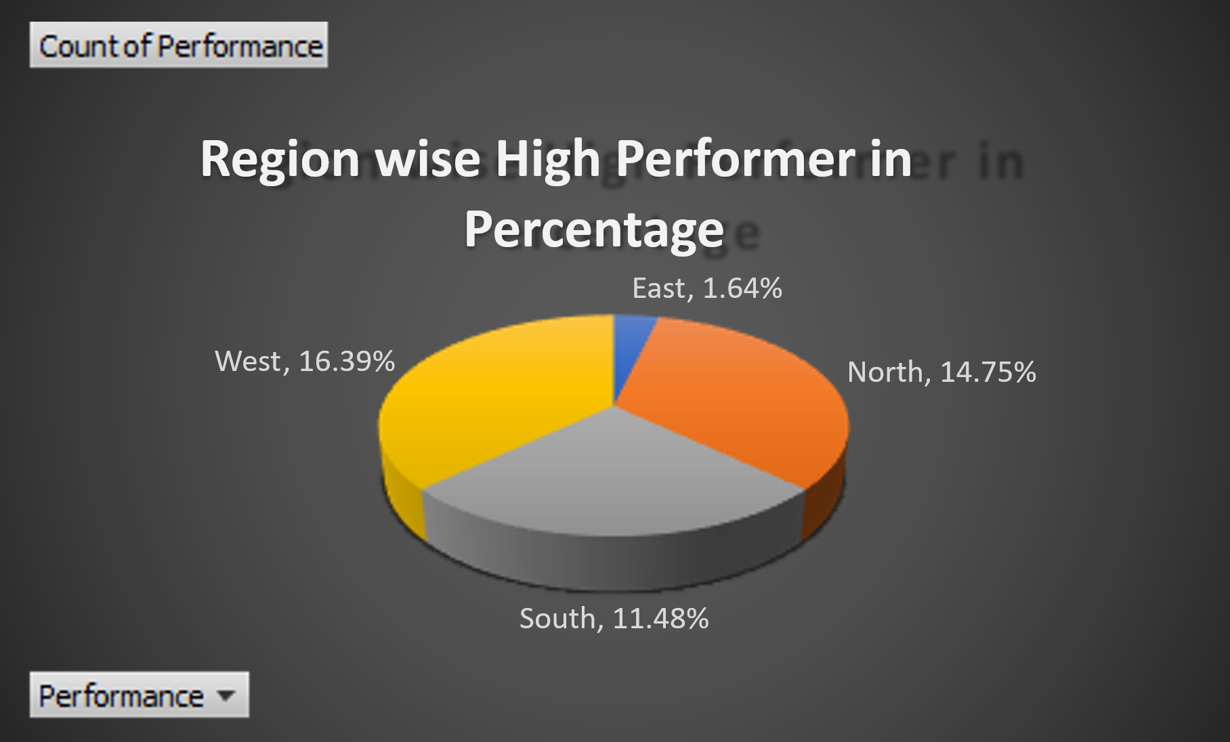
Introduction Purpose: Evaluate performance across regions based on survey data. Focus: Grade performance levels, identify high performers, and visualize insights. Source: Data collected by Bare International. Methodologies If-statements to assign grades (High, Medium, Low) based on evaluation scores. Pivot tables to calculate average evaluation scores by zone. Percent distribution analysis of performance grades. Visual tools: charts and tables to summarize findings.

Slide 3
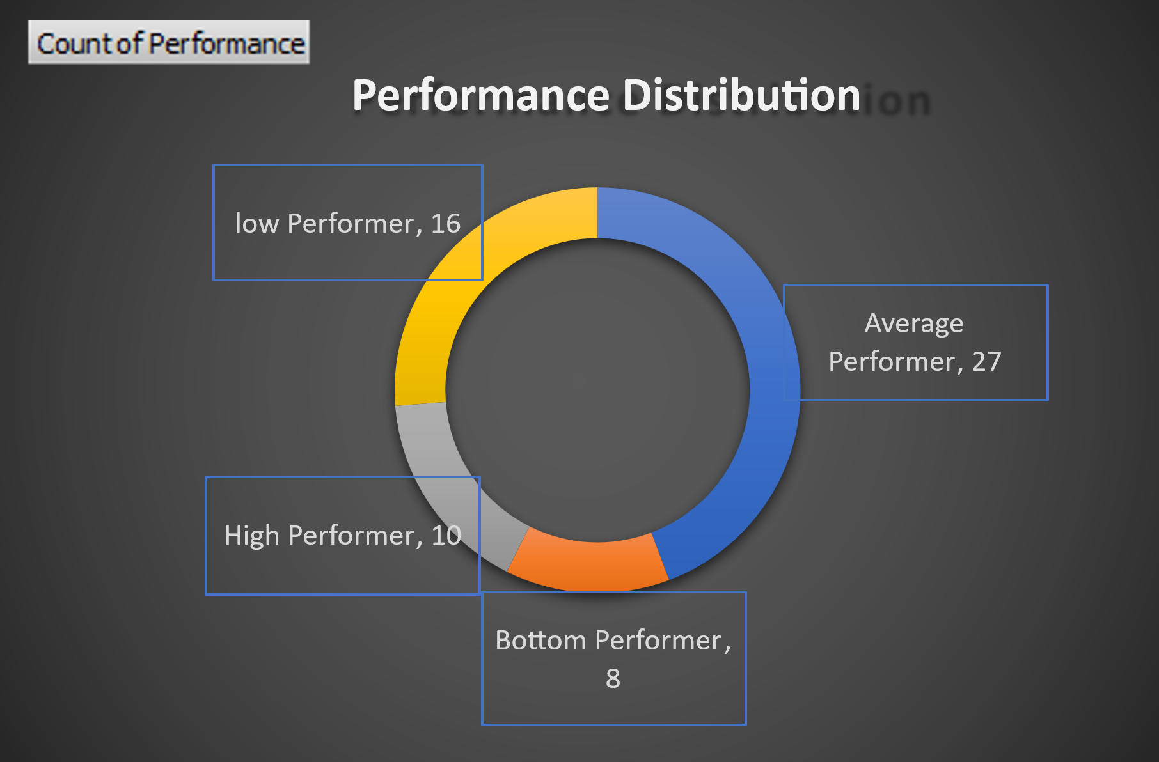
Approaches Created rules to classify Evaluation Scores: High: > 80 Medium: 60–80 Low: < 60 Aggregated results by geographic zones. Compared scores and performance percentages across regions. Developed visual and tabular representations.

Slide 4
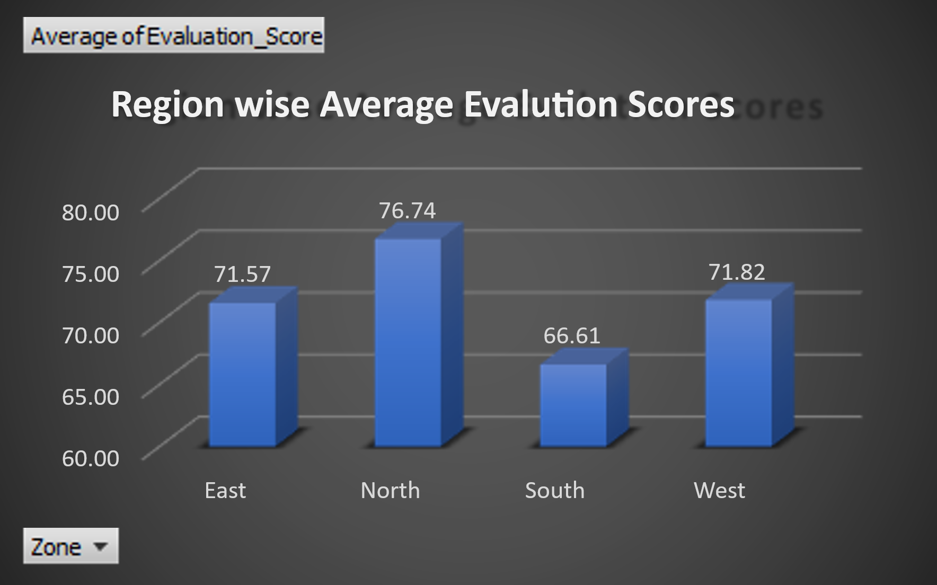
Key Findings Average Evaluation Scores by Zone: North: 76.7 East: 71.6 South: 66.6 West:71.82 North Zone had the highest share of High performers. South Zone had lower scores and fewer High performers. Performance is not uniform across regions.

Slide 5
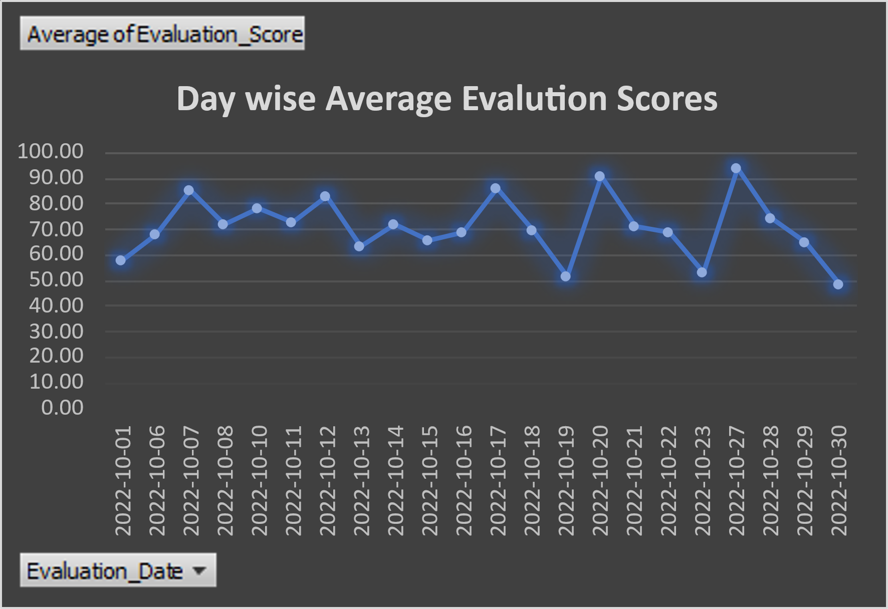
Insights Evaluation_Score is an effective indicator of zone performance. Grading revealed clear strengths and weaknesses. Visualization simplifies complex performance data. Actionable Insights Strengthen support in South Zone (e.g., training, process review). Study North Zone’s best practices and replicate in other regions. Prioritize feedback collection from underperforming zones.

Slide 6
Conclusions Notable performance disparity between regions. Opportunities for targeted interventions and cross-regional learning. Regular review and grading can improve service consistency.

